Slide 1

CAN PROTOCOL
Namit Nagpal
SV P ED T CC BLR

Slide 2
CAN – History, Motivation & Application
Brief history of CAN:
  1991 – First official release of CAN specification by BOSCH AG
  1992 – First CAN equipped car used by Mercedes – Benz (S)
  1993 – ISO11519 (ISO11898) takes over CAN specification
  1995 – Release CAN 2.0B (Extended frame format)
Motivation:
  Standard on a serial protocol for Inter-ECU communication
Application:
  Inter-ECU data exchange (e.g. Senor-sharing)
  Network-Management, Calibration & Diagnosis protocols

Slide 3
FEATURES
Information routing - Message routing – Message identifier
  - Multicast – message filtering
  - Data Consistency
Flexible –add or remove nodes
Bit-rate – Different for Networks ; uniform within a network
Priorities – Identifier
Remote Data Request: Request for a Data frame
Multi-master operations –each can node able to access the bus
*******

Slide 4
FEATURES
Data Integrity
  Error detection by monitoring, Cyclic Redundancy Check (CRC), Bit- stuffing, Message frame check.
  Performance of error detection -All global errors & local errors at transmitter are detected.
Error signaling & recovery time
  Corrupted messages
  Recovery time b/w error detection & next message is 29bit time.
Fault confinement
  Distinguish b/w short & permanent failures.

Slide 5
FEATURES
Connections
  - No limit of Max no. of nodes
Single channel
  - channel implementation is not fixed
Bus values
  - Dominant – Logical Zero
  - Recessive – Logical One
Acknowledgement
  - ACK for consistent message
  - Flag an inconsistent message

Slide 6
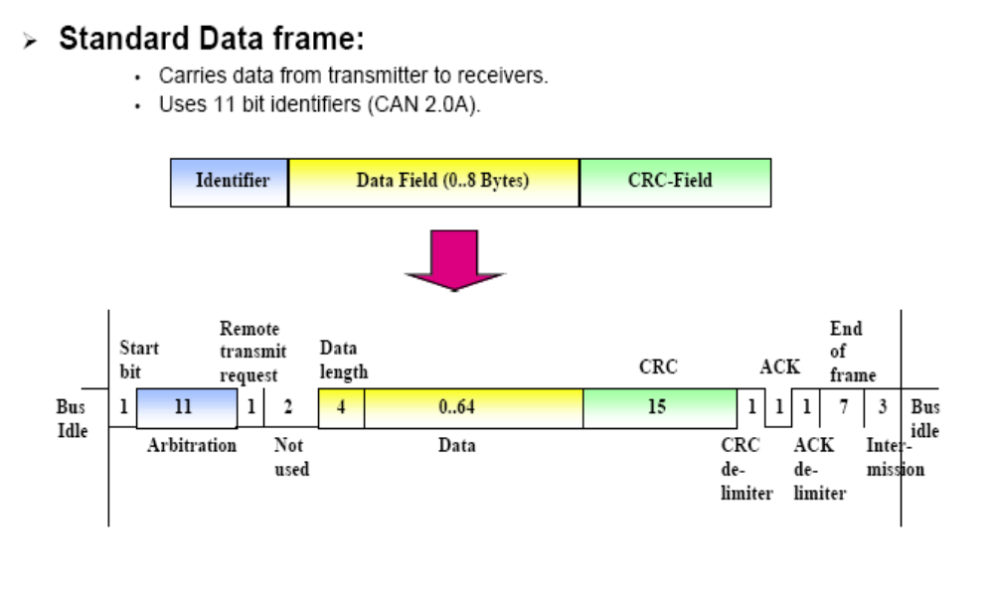

Slide 7
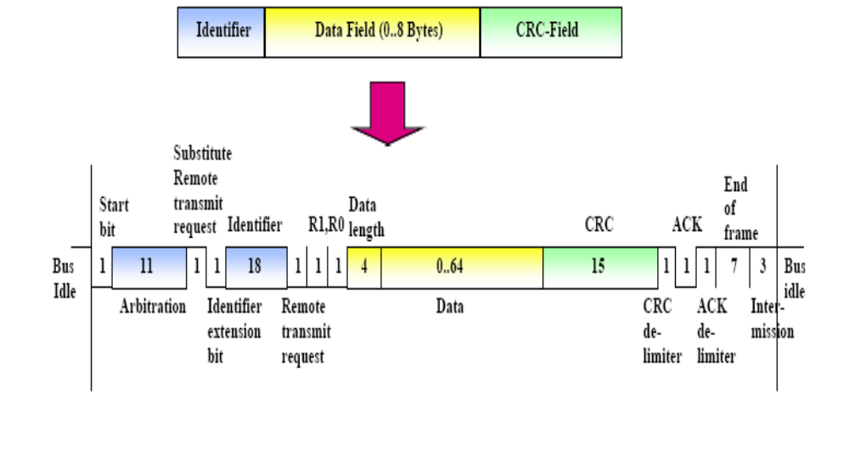

Slide 8
CAN: Summary of the Basic Protocol Features
Bit-serial transmission of data packages up to 8 bytes length
NRZ-Coding plus bit-stuffing
Multiple master
Priority based Media Access Control: CSMA / CA
Message addressing
Broadcast: All CAN-controller receive all messages sent via the bus
Message filtering, message buffering
Error notification, error confinement, automatic retransmission

